Slide 1

Automata Theory Lecture: 17 Ambiguous Grammar
Farhad Muhammad Riaz

Slide 2
Ambiguity & Ambiguous Grammar
Parse trees and syntax trees uniquely express the structure of syntax, as do leftmost and rightmost derivations, but not derivations in general
It is possible for a grammar to permit a string to have more than one parse tree
A grammar that generates a string with two distinct parse trees is called ambiguous grammar

Slide 3
Ambiguity & Ambiguous Grammar (Continue…)
One method to deal with ambiguities is to state a disambiguating rule that remove ambiguity without changing grammar but syntactic structure of language is no longer given by the grammar alone
The alternative is to change the grammar into a form that forces the construction of the correct parse tree, thus removing the ambiguity

Slide 4
Ambiguity & Ambiguous Grammar
exp → exp op exp | ( exp ) | number
op → + | - | *

Slide 5
Parse Tree of 10-15*2
Which Parse Tree is correct?

Slide 6
Example
S → aSb | SS
S → ε

Slide 7
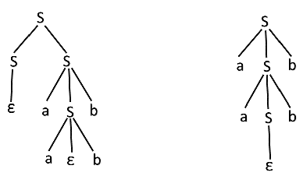
For the string "aabb" the above grammar can generate two parse trees

Slide 8
How to Remove Ambiguity?
To remove ambiguity we could now state a disambiguating rule that establishes a relative precedence of three operations i.e. +, - and *
The addition and subtraction operation will get same precedence but multiplication will get higher precedence
This ambiguity can be removed by stating a disambiguating rule of associativity of each of the operations

Slide 9
Introducing Precedence
exp → exp op exp | ( exp ) | number
op → + | - | *
CHANGED TO
exp → exp addop exp | term
addpp → + | -
term → term mulop term | factor
mulop → *
factor → ( exp ) | number
Note: We still have a problem in new CFG

Slide 10
Introducing Associativity
Removed recursion and introduced left-association
exp → exp addop term | term
addpp → + | -
term → term mulop factor | factor
mulop → *
factor → ( exp ) | number

Slide 11
Ambiguity & Ambiguous Grammar
S → a | aAb | abSb A → aAAb | bS
S ⟹ aAb ( ∵ S → aAb) ⟹ abSb (∵ A → bS) ⟹ abab (∵ S → a)
S ⟹ abSb ( ∵ S → abSb) ⟹ abab (∵ S → a)

Slide 12
Chomsky Normal Form
A context-free grammar is in Chomsky Normal Form if each rule has one of these forms:
X → a
X → YZ
That is, the right-hand side is either a single terminal or two non-terminals.
Convention: uppercase letters denote non-terminal symbols and lowercase letters denote terminal symbols.

Slide 13
Objective
This mini-tutorial will answer these questions:
What is Chomsky Normal Form?
A context-free grammar is in Chomsky Normal Form if each rule has one of these forms:
X → a
X → YZ
Why is Chomsky Normal Form useful/relevant?
The production trees for grammars in Chomsky Normal Form are binary trees. Binary trees are well-studied. The results from research on binary trees can be applied to grammars in Chomsky Normal Form.

Slide 14
ε-rules, ε-free
A grammar rule that has an empty right-hand side, e.g., A → ε is called an ε-rule. Read that rule as: A may be replaced by the empty string (which we denote by ε).
A grammar that contains no such rules is called ε-free.

Slide 15
Transform any context-free grammar to Chomsky Normal Form
To every ε-free context-free grammar one can find an equivalent grammar in Chomsky Normal Form.
Context-free grammar
Context-free grammar
in Chomsky Normal Form
transform

Slide 16
Example of a grammar that is transformed to Chomsky Normal Form
S → AaBb
A → aB
B → b
S → AX₁
A → A₁B
B → b
A₁ → a
B₁ → b
X₁ → A₁X₂
X₂ → BB₁
transform
Chomsky Normal Form

Slide 17
3-step process
The following slides shows a 3-step process for transforming any context-free grammar into an equivalent grammar in Chomsky Normal Form.

Slide 18
Step 1: replace terminals mixed in with non-terminals
Q → aP
Q → A₁P
A₁ → a
Step 1

Slide 19
Example
S → AB
A → aCa
A → a
B → bB
B → b
C → D
D → d
S → AB
A → A₁CA₁
A → a
B → B₁B
B → b
C → D
D → d
A₁ → a
B₁ → b
Step 1
Replace the right-hand side, aCa, by A₁CA₁ and then add a new rule A₁ → a
Replace the right-hand side, bB, by B₁B and then add a new rule B₁ → b

Slide 20
Step 2: convert sequence of non-terminals to pairs of non-terminals
For every rule with a right-hand side that contains 3 or more non-terminals, replace all non-terminals but the first by X_{i} and then add a new rule where X_{i} has as its right-hand side those non-terminals that were replaced by X_{i}
Repeatedly apply Step 2 until there are no rules with more than two non-terminals on the right-hand side.
Q → ABCDE
Q → AX₁
X₁ → BX₂
X₂ → CX₃
X₃ → DE
Step 2

Slide 21
Repeatedly apply step 2
Q → ABCDE
Q → AX₁
X₁ → BCDE
Q → AX₁
X₁ → BX₂
X₂ → CDE
Step 2
Step 2
Step 2
Q → AX₁
X₁ → BX₂
X₂ → CX₃
X₃ → DE

Slide 22
Applying step 2 to a grammar
S → AB
A → A₁CA₁
A → a
B → B₁B
B → b
C → D
D → d
A₁ → a
B₁ → b
S → AB
A → A₁X₁
A → a
B → B₁B
B → b
C → D
D → d
A₁ → a
B₁ → b
X₁ → CA₁
Step 2
Replace the right-hand side, A₁CA₁, by A₁X₁ and then add a new rule X₁ → CA₁

Slide 23
3 kinds of rules remain
After performing steps 1 and 2, the resulting grammar has three kinds of rules:
X → a
X → Y
X → YZ

Slide 24
Rules of the form: X → a
X → a
X → Y
X → YZ
S → AB
A → A₁X₁
A → a
B → B₁B
B → b
C → D
D → d
A₁ → a
B₁ → a
X₁ → CA₁

Slide 25
Rules of the form: X → Y
X → a
X → Y
X → YZ
S → AB
A → A₁X₁
A → a
B → B₁B
B → b
C → D
D → d
A₁ → a
B₁ → a
X₁ → CA₁

Slide 26
Rules of the form: X → YZ
X → a
X → Y
X → YZ
S → AB
A → A₁X₁
A → a
B → B₁B
B → b
C → D
D → d
A₁ → a
B₁ → a
X₁ → CA₁

Slide 27
Chain rules
Rules with the form X → Y are called chain rules.

Slide 28
Chain rules aren’t in Chomsky Normal Form
Recall the definition of Chomsky Normal Form:
A context-free grammar is in Chomsky Normal Form if each rule has one of these forms:
X → a
X → YZ
Chain rules are of this form: X → Y
Clearly that is not Chomsky Normal Form.
So we must transform chain rules into the desired form.

Slide 29
Step 3: remove chain rules
Consider this chain rule: X → Y
From the previous few slides we know that the rule for Y must have one of these forms:
Y → a
Y → Z
Y → YZ
If there is a rule Y → a then replace X → Y by X → a
If there is a rule Y → YZ then replace X → Y by X → YZ
If there is a rule Y → Z then replace X → Y by the result of replacing Z (recursive definition – cool!)

Slide 30
Example
S → AB
A → A_{i}X_{i}
A → a
B → B_{i}B
B → b
C → D
D → d
A_{i} → a
B_{i} → a
X_{i} → CA_{i}
S → AB
A → A_{i}X_{i}
A → a
B → B_{i}B
B → b
C → d
D → d
A_{i} → a
B_{i} → a
X_{i} → CA_{i}
Step 3
Chomsky Normal Form
There is one chain rule: C → D
D is defined by this rule: D → d
So, replace the chain rule with: C → d

Slide 31
Another example
S → A
A → B
B → b
S → b
A → b
B → b
Step 3
This is a chain rule: S → A
A is defined by this chain rule: A → B
B is defined by this rule: B → b
So, replace the first chain rule with: S → b
And, replace the second chain rule with: A → b

Slide 32
Multiple rules may be generated
Consider this rule: X → Y
The rule for Y may be an alternative: Y → a | Z | AB
So the rule for X must be replaced by: X → a X → AB
plus the rule(s) generated by replacing Z

Slide 33
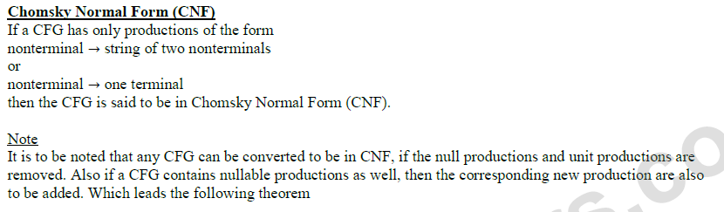

Slide 34
Theorem
All NONNULL words of the CFL can be generated by the corresponding CFG which is in CNF i.e. the grammar in CNF will generate the same language except the null string

Slide 35
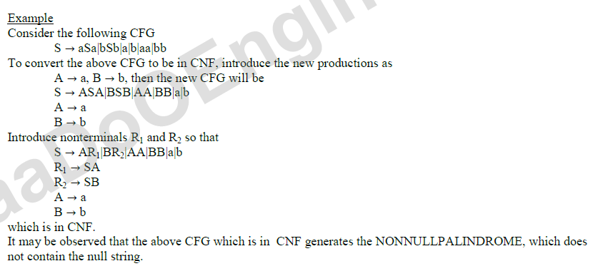

Slide 36
S → a | aA | B
A → aBB | ε
B → Aa | b

Slide 37
Step 1: We will create a new production S1 → S, as the start symbol S appears on the RHS. The grammar will be:
S1 → S
S → a | aA | B
A → aBB | ε
B → Aa | b

Slide 38
Step 2: As grammar G1 contains A → ε null production, its removal from the grammar yields:
S1 → S
S → a | aA | B
A → aBB
B → Aa | b | a

Slide 39
Now, as grammar G1 contains Unit production S → B, its removal yield:
S1 → S
S → a | aA | Aa | b
A → aBB
B → Aa | b | a
Also remove the unit production S1 → S, its removal from the grammar yields:
S0 → a | aA | Aa | b
S → a | aA | Aa | b
A → aBB
B → Aa | b | a

Slide 40
Step 3: In the production rule S0 → aA | Aa, S → aA | Aa, A → aBB and B → Aa, terminal a exists on RHS with non-terminals. So we will replace terminal a with X:
S0 → a | XA | AX | b
S → a | XA | AX | b
A → XBB
B → AX | b | a
X → a

Slide 41
Step 4: In the production rule A → XBB, RHS has more than two symbols, removing it from grammar yield:
S0 → a | XA | AX | b
S → a | XA | AX | b
A → RB
B → AX | b | a
X → a
R → XB

